Slide 1
Passing Data and States Between Components

Slide 2

What you will learn

Slide 3
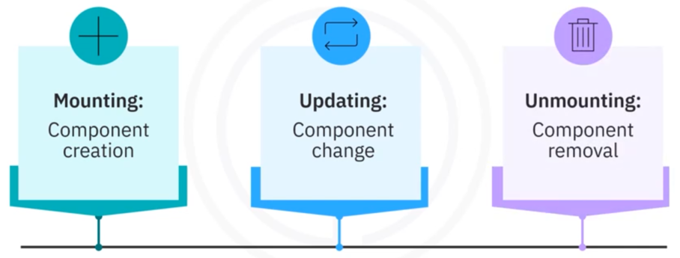
Component phases

Slide 4

Mounting
When a component is created, four methods are called in the same order:
1. Constructor
2. getDerivedStateFromProps()
3. render()
4. componentDidMount()

Slide 5

Updating
When a component is created, five methods are called in the same order:
1. getDerivedStateFromProps()
2. shouldComponentUpdate()
3. render ()
4. getSnapshotBeforeUpdate()
5. componentDidUpdate()

Slide 6
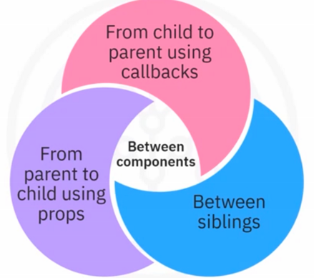
Passing data between components

Slide 7
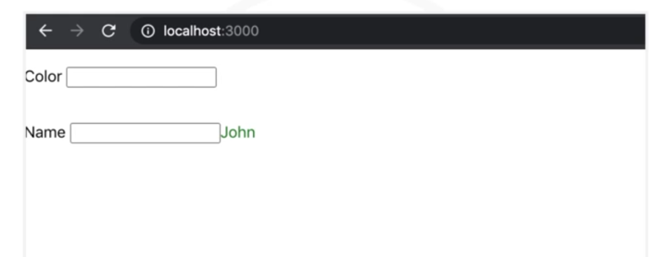
Passing data from parent to child

Slide 8
Passing data from parent to child

Slide 9

Passing data from parent to child

Slide 10
Passing data from parent to child

Slide 11

Passing data from child to parent

Slide 12
Recap
In this video, you learned that:
• Each React component has three phases in its lifecycle:
mounting, updating, and unmounting
• When a component is created or updated, methods are called in
the same order
• You can pass data between components from parent to child
using properties, from child to parent using callbacks, and
between siblings

